Slide 1
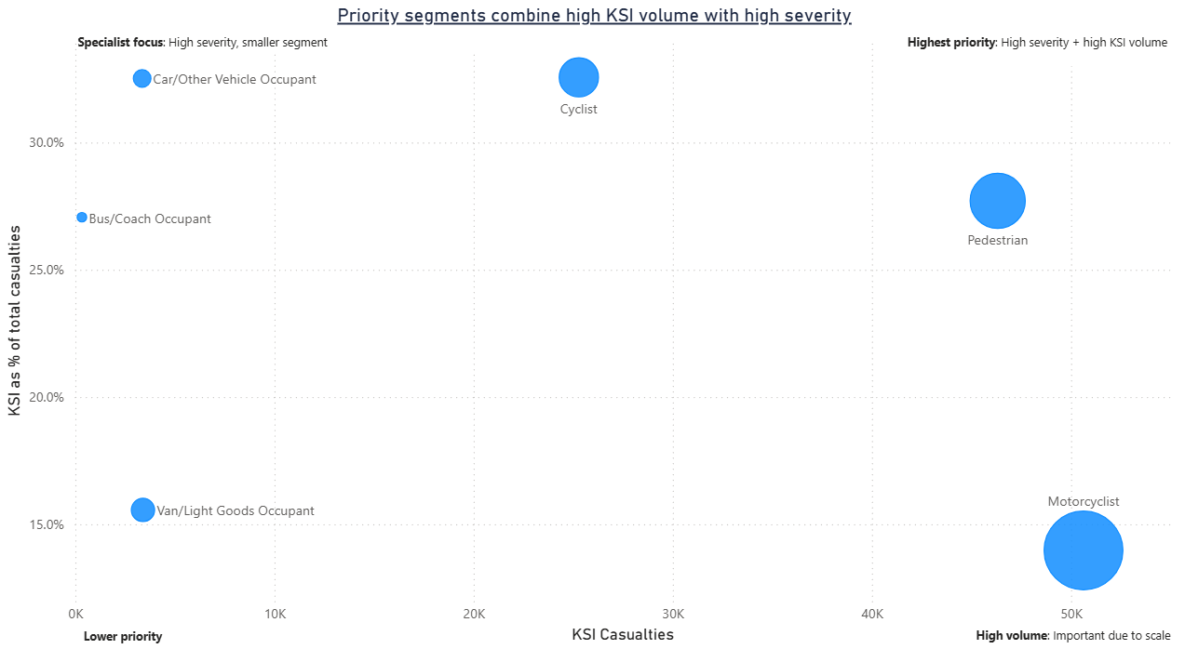
Refocus road-safety investment on urban pedestrian hotspots, higher-speed severity corridors, and high-rate authorities
Analysis of the last five years of UK road casualty data shows that severe harm is concentrated rather than evenly distributed, making targeted pilots more effective than broad, undifferentiated intervention.
PRIORITY SEGMENT VIEW
1. Prioritise urban pedestrian hotspots Concentrate early interventions where pedestrian ‘Killed or Seriously Injured’ (KSI) volume and implementation relevance are highest.
2. Target higher-speed severity corridors Use speed, road-context and timing evidence to focus enforcement and engineering where harm severity is greatest.
3. Select pilots using both count and rate Choose authorities that remain high-risk on both KSI count and KSI per 100k rather than relying on absolute volume alone.
Implication: shift investment from broad, undifferentiated activity to focused, segment-led pilot interventions.

Slide 2
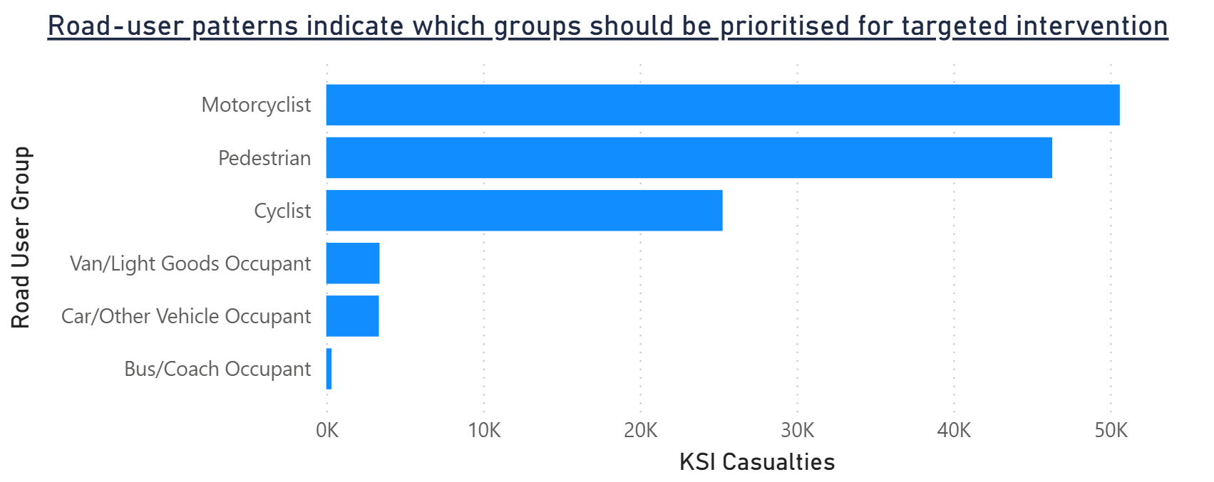
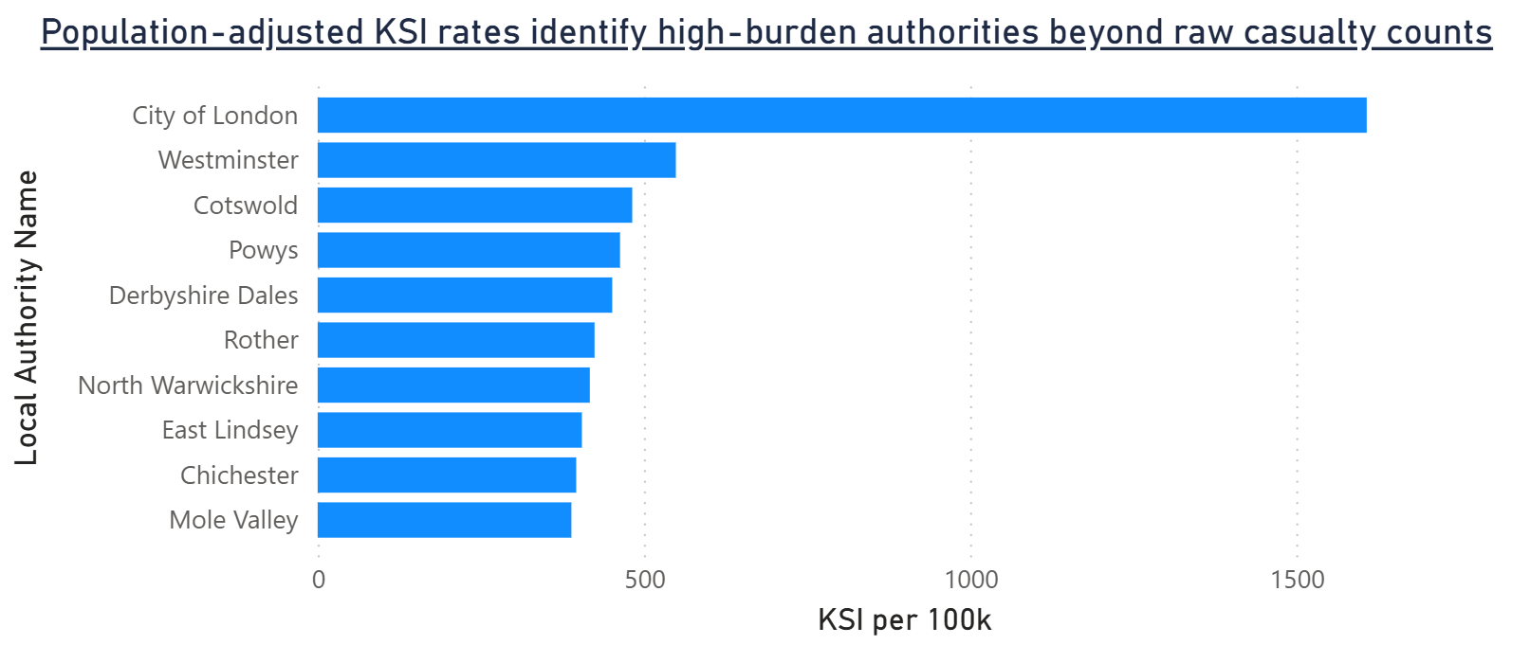
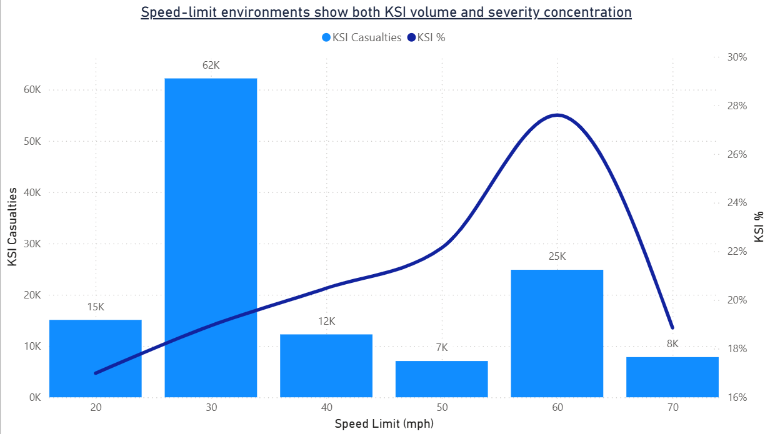
Severe harm is concentrated in a small number of road-user, authority and road-context segments
Volume, rate and environment views point consistently to concentrated rather than diffuse risk.
Road-user mix shows that severe harm is not evenly distributed and supports targeted rather than generic intervention.
Population-adjusted rates change which authorities appear highest-burden and should influence pilot selection.
Road environment matters: higher-speed settings can combine lower volume with greater severity concentration.
Overall takeaway: the problem is concentrated across a limited number of people, places and environments, which supports focused intervention rather than blanket, broad-based activity.

Slide 3
Different risk lenses point to three concrete intervention priorities
The objective is to move from analysis to targeted action.
PRIORITY MATRIX
Priority 1 ⏐ Urban pedestrian hotspots Why now: High KSI volume and strong intervention relevance in dense environments. Actions: Crossings, junction redesign, traffic calming, visibility upgrades. KPI: Pedestrian KSI.
Priority 2 ⏐ Higher-speed severity corridors Why now: Lower-volume settings may still carry high severity and should not be deprioritised. Actions: Route reviews, speed management, signage, targeted enforcement. KPI: KSI on 50/60/70 mph roads.
Priority 3 ⏐ High-rate authorities and equity-sensitive targeting Why now: Population-adjusted burden highlights authorities masked by absolute counts alone, while deprivation patterns can help prioritise where intervention may have the greatest equity value. Actions: Focused hotspot reviews, local pilot funding, monthly KPI governance, and equity-sensitive targeting. KPI: KSI per 100k in target authorities, KSI by IMD decile.
Recommendation logic: prioritise where volume, severity and actionability are strongest at the same time.

Slide 4
A 90-day pilot and KPI framework can convert analysis into measurable action
Pilot first, validate locally, then scale what works.
DAYS 1-30 ⏐ VALIDATE
DAYS 31-60 ⏐ LAUNCH
DAYS 61-90 ⏐ EVALUATE
Confirm top authorities and priority segments
Review hotspot locations and local context
Define intervention packages and owners
Deploy pilot interventions in target areas
Begin weekly dashboard review rhythm
Track operational issues and data quality
Compare KPI movement versus baseline
Refine targeting and intervention mix
Recommend scale-up, stop or redesign
Pilot KPI framework
Monthly steering questions
KSI casualties in pilot segments
KSI % in pilot segments
Are the same segments still highest priority?
Are pilot authorities high on both rate and count?
Which interventions show the clearest early signal?
What should be scaled, stopped or redesigned?
Pedestrian KSI in target corridors
KSI per 100k in target authorities and IMD-linked burden in target authorities

